Slide 1
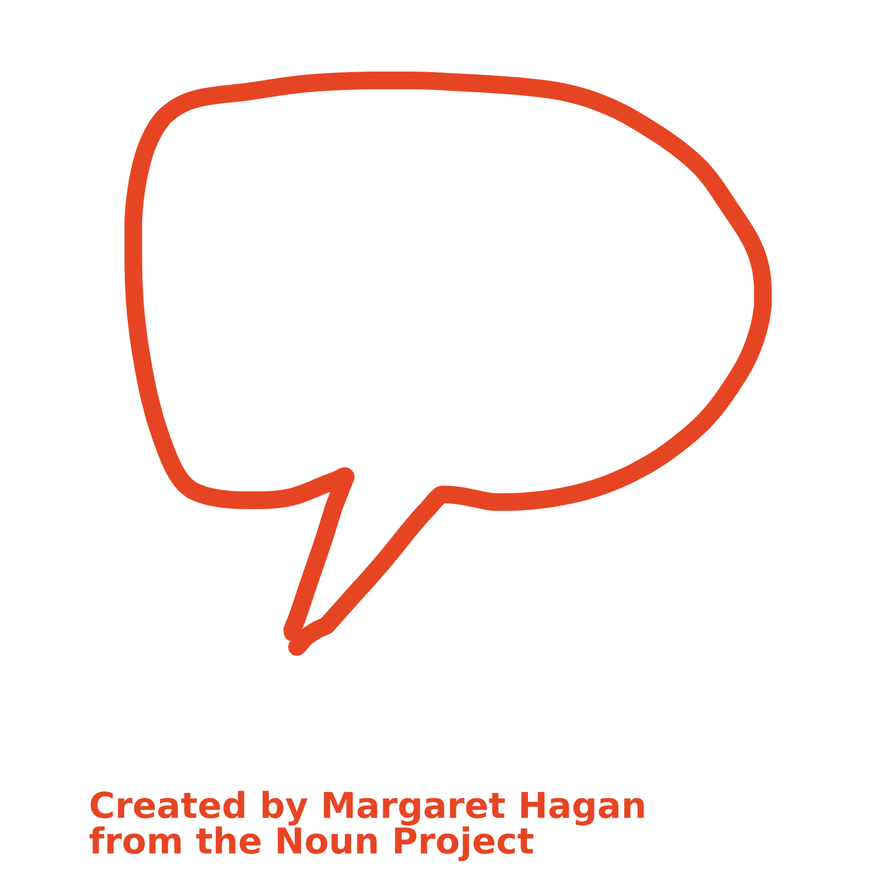
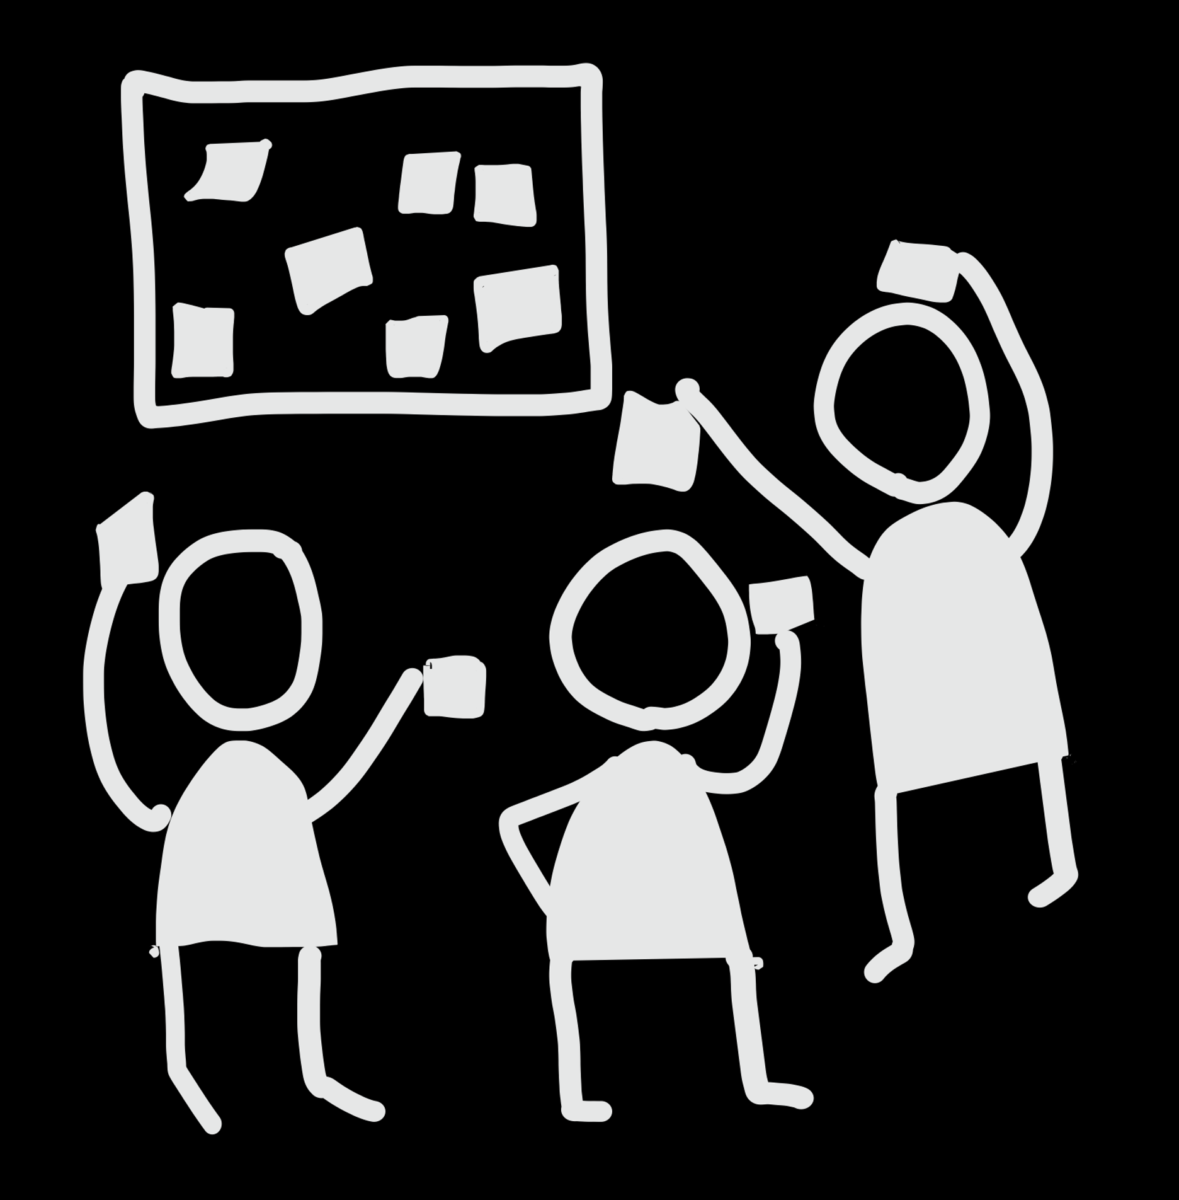
Unleashing Information and Digital Literacy Skills through generative AI

Slide 2
Agenda:
Introduction (AI + IDL): 5 mins
Examples: 10 mins
Activity (chat at table + brainstorm): 25 mins
Wrap Up: 5 mins

Slide 3
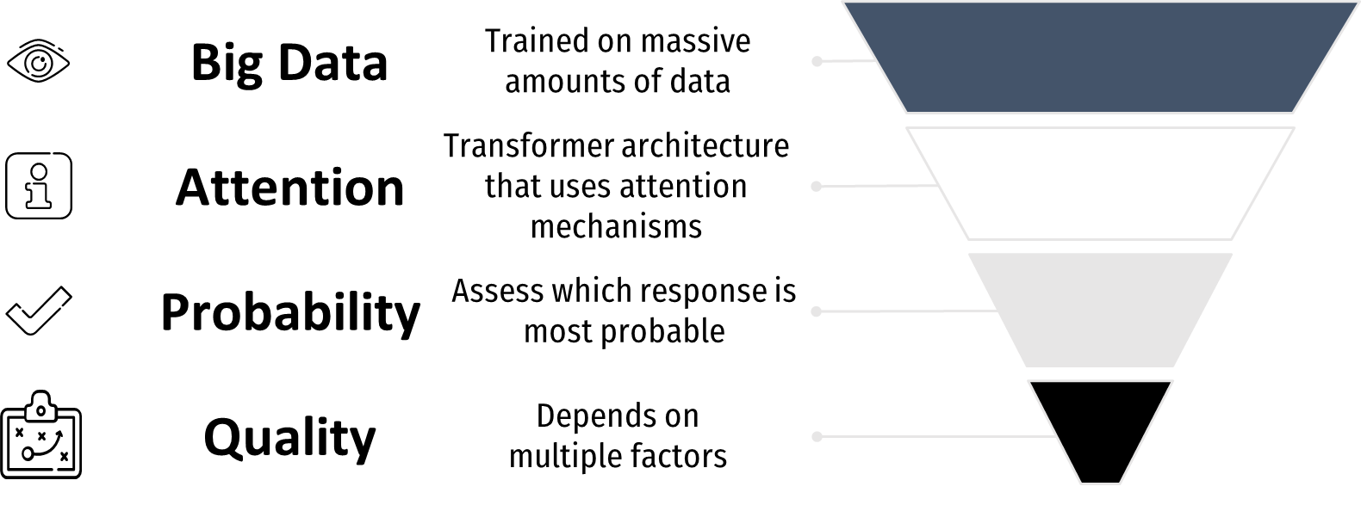
Introduction to IDL and Generative AI
Notes:
Generative AI tools is trained on massive amounts of text data using a technique called unsupervised learning. This means that it does not require labelled data, but rather learns from patterns in the data. For example, it might learn that certain words tend to follow others, or that certain phrases are more common in certain contexts.
The key innovation behind these tools like is its use of a transformer architecture that uses attention mechanisms to learn the relationships between words and generate coherent text. The attention mechanism allows the model to focus on certain parts of the input text while generating the output text, which improves its ability to generate coherent and contextually relevant text.
When generating text, ChatGPT uses a probabilistic approach to generate the most likely words given the input prompt. This means that it generates multiple possible outputs and assigns a probability to each one based on how likely it is to be a good fit for the input prompt.
The quality of the generated text depends on several factors, including the amount and quality of the training data, the complexity of the prompt, and the size of the model. Larger models tend to generate better text, but they also require more computing power and resources.
These tools address the underlying issue of information and digital literacy in students. IDL is a graduate quality, and what underpins this is… (next slide)

Slide 4
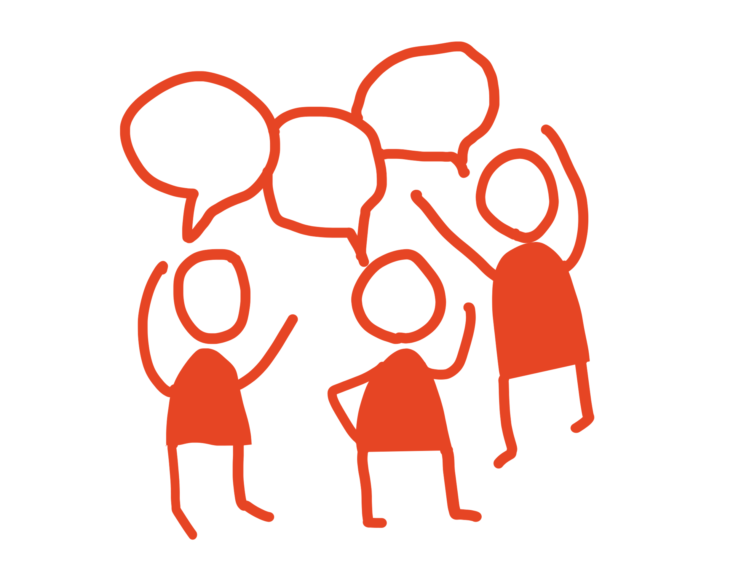
Graduate Quality: IDL
Information and digital literacy is the ability to locate, interpret, evaluate, manage, adapt, integrate, create and convey information using appropriate resources, tools and strategies.

Slide 5
Unpacking IDL skills
Scope an information need
Location of information and data
Interpretation and evaluation of data
Adoption, integration and synthesis
Use of digital resources, tools and strategies
Ethical and legal access and use of information and data

Slide 6
Example 1: Location of data and information
IDL skill level | Activity | AI use
Identifies main concepts when researching a straightforward question or problem, with minimal reference to context (1) Evaluates a variety of search strategies and sources and selects an appropriate set of these to use (2) | Scenario: Students act as an education policy advisor developing a discussion paper on young children's transition to school. They need to conduct a literature search to find out about existing programs/strategies and how effective they are. Instructions: 1. Use ChatGPT to suggest additional synonyms for your main concepts 2. Evaluate the suggestions. Which suggestions would you incorporate into your work and why? 3. Perform the search in your chosen database. How relevant were your results? 4. Compare the results with another AI search tool e.g. Elicit.org. Which search tool is most effective and why? | Brainstorming Evaluative judgment
Students need to understand what main concepts and synonyms are, how to structure a search using boolean operators and brackets, and how to apply search syntax to keyword terms
Notes:
Show an example prompt
We’ve chosen a scenario but you can work on your own scenario to include applicable detail to your discipline, to ensure assessments are authentic whilst using the component of the rubric identified here.
Boolean logic and synonyms are strengths of tools for ChatGPT

Slide 7
ChatGPT Prompts
Act as an expert librarian with knowledge of constructing searches in scholarly databases. Provide suggestions for synonyms for a search on transition programs for young children
Read the ChatGPT responses

Slide 8
Example 2: Interpretation and evaluation of sources
IDL skill level | Activity | AI use
Independently applies basic criteria to judge the value of information in a disciplinary context (2) | Scenario: Students evaluate a source they are planning to use for an assignment. Instructions: Use ChatGPT to generate evaluation criteria suggestions. Which ones are most appropriate for your disciplinary context? What's missing? Instruct ChatGPT to act as a tutor and ask you questions based on the evaluation criteria After evaluating the source, what is your overall judgment? Could the ChatGPT responses have influenced your decision? | Brainstorming Q&A
To complete this activity, students need to know some evaluation criteria/methods and have selected a source to evaluate ***Remind students not to include any copyrighted information into ChatGPT prompts or responses
Notes:
Show an example prompt

Slide 9
ChatGPT Prompt
1. What are some criteria or methods that can be used to evaluate a journal article for a university assignment?
2. Act as a tutor in [insert program and year level]. Ask me questions based on the evaluation criteria above that will help me to evaluate the information in a journal article for my assignment on [insert topic]:
Read the ChatGPT responses
Additional evaluation resources General evaluation criteria checklists: CRAAP, TRAAP
Hjørland, B. (2012). Methods for evaluating information sources: An annotated catalogue. Journal of Information Science, 38(3), 258-268. https://doi.org/10.1177/0165551512439178

Slide 10
Example 3: Ethical and legal access and use of data and information Interpretation and evaluation of sources
IDL skill level | Activity | AI use
Independently follows ethical, legal and disciplinary standards in sourcing data or information at a basic level to cite sources and indicate direct reuse (2) Independently applies basic criteria to judge the value of information in a disciplinary context (2) Applies commonly used search tools and strategies provided to access and select data and information (2) | Scenario: Students act as a science communicator and use ChatGPT to write the first draft of a short article on the development of a GM food. Instructions: Ask ChatGPT to write a news report on the development of GM mandarins in the 2000s and 2010s and include relevant academic sources provided in APA 7th referencing style. Which statements or claims require a citation? Check the sources that have been provided. Can you verify them? Use the same prompt in Perplexity, which has web connectivity. Compare the outputs and sources provided. Are the sources verifiable? Is legal access provided to the sources? Evaluate the Perplexity sources. Then conduct your own search to find 1 or 2 higher quality sources. | Drafting Evaluative judgement
To complete this activity, students need to know some evaluation criteria/methods
Notes:
Show an example prompt
https://www.perplexity.ai/search/918ecc0a-bde8-44fb-af63-204971fe8524?s=c
https://chat.openai.com/share/68cd8007-cfc8-420e-bf94-9eea76a99ed1
Students create a prompt that asks ChatGPT/perplexity write a short piece on ____topic and provide some references in support of it. Fact check the text, work out the sources, are they real & the tutor can lead discussions around reflective questions around the ethics of source attribution and hallucination of generative AI and how the tool demonstrates how they go about searching (discussion point).

Slide 11
ChatGPT/Perplexity Prompts
You're a science communicator and have to write a piece on the development genetically modified mandarins to support the taste and overall quality in the 2000s and 2010s. Write a news report, including 5 academic sources written in APA referencing style.
Read the ChatGPT responses
Read the Perplexity responses
Notes:
https://www.perplexity.ai/search/918ecc0a-bde8-44fb-af63-204971fe8524?s=c
https://chat.openai.com/share/68cd8007-cfc8-420e-bf94-9eea76a99ed1

Slide 12
What does IDL look like in your
discipline or unit of study?
Notes:
Contextualising

Slide 13
ACTIVITY:
bit.ly/AI-IDL
(25 mins)

Slide 14
Activity (25 mins)
Brainstorm learning activities which be can run with your students to help them develop or demonstrate IDL skills
Brainstorm what the prompt/s would need to contain for a student to complete the task. (I.e. knowledge on features of a comprehensive search, evaluation techniques/frameworks)
Brainstorm support you may need to design/develop this activity
Notes:
Academics use their skillset/SME
You now have a definition of the IDL skill on your table + what this skill looks like (rubric rows?)

Slide 15
1.Brainstorm learning activities which can be run with your students
to help them develop or demonstrate IDL skills
2.Brainstorm what the prompt/s would need to contain for a student to complete the task. (E.g. knowledge on features of a comprehensive search, evaluation techniques/frameworks)
3.Brainstorm support you may need to design/develop this activity

Slide 16
KEY TAKEAWAYS + NEXT STEPS
(5 mins)

Slide 17
Partnering with the Library
Visit the University of Sydney Library Teaching Support page
Contact the Library

